Slide 3
Array, Vectors, Matrices
Array: A collection of data values organized into rows and columns and known by a single name.
Arrays can be classified as vectors and matrices.
Vector: Array with one dimension
Matrix: Array with more than one dimension
Size of an array is specified by the number of rows and the number of columns, with the number of rows mentioned first (n x m).
Notes:
Total number of elements in an array is the product of the number of rows and the number of columns.

Slide 4
Row and Column Vectors
Row Vector
  rowVector = [1 2 3 4 5]; % Using spaces
  rowVector2 = [1, 2, 3, 4, 5]; % Using commas
Column Vector:
colVector = [1; 2; 3; 4; 5]; % Semicolons separate rows

Slide 5
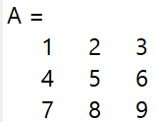
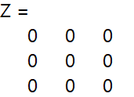
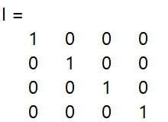

Creating Matrices
Manually:
A = [1 2 3; 4 5 6; 7 8 9]; % 3x3 matrix
Using zeros, ones, and eye:
Z = zeros(3,3); % 3x3 matrix of zeros
O = ones(2,4); % 2x4 matrix of ones
I = eye(4); % 4x4 identity matrix

Slide 6
Vectors vs. Matrices
1 2
3 4
5 6
a=
3x2 matrix → 6 elements
b=[1 2 3 4]
1x4 array → 4 elements, row vector
1
3
5
c=
3x1 array → 3 elements, column vector
a(2,1)=3 b(3)=3 c(2)=3
Row #
Column #

Slide 7
Example
Define a 3×3 matrix where the first row is [2,4,6], the second row is [8, 10, 12], and the third row is [14,16,18].
  A = [2,4,6; 8, 10, 12; 14,16,18];

Slide 8
Some Special Vectors and Matrices
>> v = ones(1,4)
v =
1 1 1 1
>> m = ones(3)
m =
1 1 1
1 1 1
1 1 1
>> n = ones(2,3)
n =
1 1 1
1 1 1
>> x = zeros(1,4)
x =
0 0 0 0
>> y = zeros(3)
y =
0 0 0
0 0 0
0 0 0
>> z = zeros(2,3)
z =
0 0 0
0 0 0

Slide 9
Example
Create a row vector that has the following elements:
8, 10/4, 12×1.4, 51, tan 85°,√26 , and 0.15.
row=[8 10/4 12*1.4 51 tand(85) sqrt(26) 0.15]

Slide 10
Example
Create a 4×4 matrix of ones.
onesMatrix = ones(4,4);
Create a 3×3 identity matrix.
identityMatrix = eye(3);
Generate a 2×5 matrix filled with random values between 0 and 1
randomMatrix = rand(2,5);

Slide 11
colon :
Vector creation, array subscripting, and for-loop iteration
x = j:k creates vector x incremented by 1
  x=[4:10]
  x =
  4 5 6 7 8 9 10
x = j:i:k creates a vector x using i as the increment between elements.
  x=[4:3:15]
  x =
  4 7 10 13
  y=[15:-4:0]
  y =
  15 11 7 3

Slide 12
Example
Create a row vector containing numbers from 5 to 25 with a step of 5.
  rowVector = 5:5:25;
Create a column vector containing numbers from 10 to 50 with a step of 10.
  colVector = (10:10:50)';

Slide 13
Array Addressing
A = [1 2 3 4; 5 6 7 8; 9 10 11 12]
A =
1 2 3 4
5 6 7 8
9 10 11 12
>> A(1,:)
1 2 3 4
>> A(end,:)
9 10 11 12
>> A(:,2)
2
6
10
>> A(:,end)
4
8
12
>> A(2:7)
5 9 2 6 10 3
>> A(:)
1
5
9
2
6
10
3
7
11
4
8
12

Slide 14
Creating Matrices from Vectors
Suppose a = [1,3,5] and b = [7,9,11] (row vectors). Note the difference between the results given by [a b] and [a;b] in the following session:
>>c = [a b];
c =
1 3 5 7 9 11
>>D D = | = | [a;b]
1 |  | 3 5
7 |  | 9 11

Slide 15
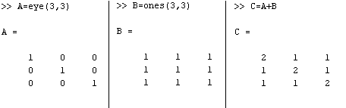
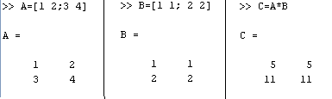
Matrix Calculations
Addition
Multiplication

Slide 16
Matrix Calculations
Multiplying a matrix A by a scalar w produces a matrix whose elements are the elements of A multiplied by w. For example:
2 9
5 –7
6 27
15 –21
3
=
This multiplication is performed in MATLAB as follows:
>>A = [2, 9; 5,-7];
>>3*A
ans =
6 27
15 -21

Slide 17
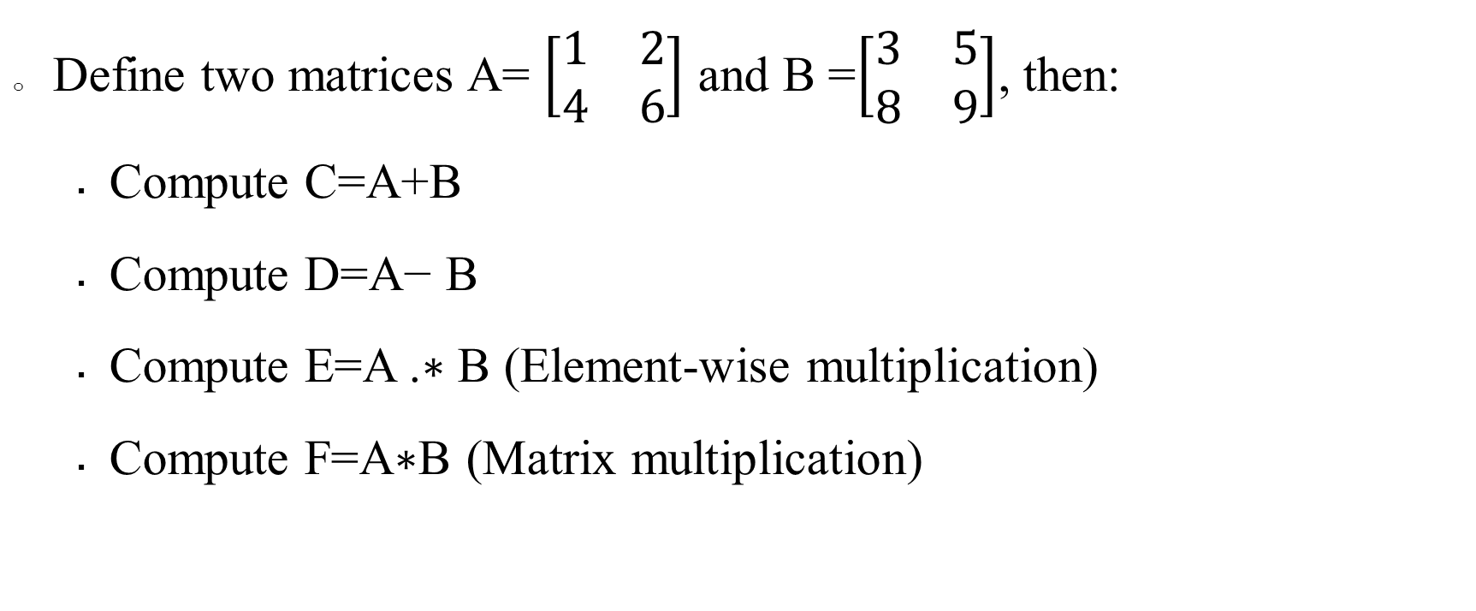
Example
Define two matrices A= $\left[\begin{matrix}1 & 2 \\ 4 & 6\end{matrix}\right]$ and B =$\left[\begin{matrix}3 & 5 \\ 8 & 9\end{matrix}\right]$, then:
  Compute C=A+B
  Compute D=A− B
  Compute E=A .∗ B (Element-wise multiplication)
  Compute F=A∗B (Matrix multiplication)

Slide 18
Solution
A=[1, 2 ; 4, 6];
B=[3, 5 ; 8, 9];
C=A+B
D=A-B;
E=A .* B;
F=A*B;
C =
4 7
12 15
D =
-2 -3
-4 -3
E =
3 10
32 54
F =
19 23
60 74

Slide 19
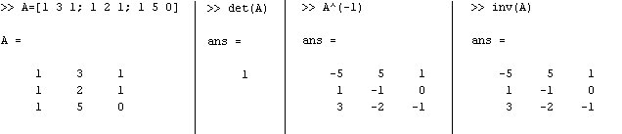
Matrix Calculations
Inverse

Slide 20
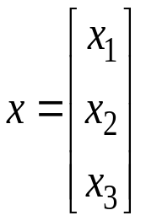
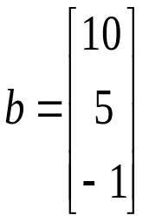
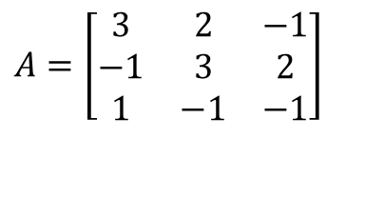
Solutions to Systems of Linear Equations
Example: a system of 3 linear equations with 3 unknowns (x₁, x₂, x₃):
3x₁ + 2x₂ – x₃ = 10
-x₁ + 3x₂ + 2x₃ = 5
x₁ – x₂ – x₃ = -1
$$A=\left[\begin{matrix}3 & 2 & −1 \\ −1 & 3 & 2 \\ 1 & −1 & −1\end{matrix}\right]$$
Then, the system can be described as:
Ax = b

Slide 21
Solutions to Systems of Linear Equations
Solution by Matrix Inverse:
  Ax = b
  A⁻¹Ax = A⁻¹b
  x = A⁻¹b
MATLAB:
  >> A = [ 3 2 -1; -1 3 2; 1 -1 -1];
  >> b = [ 10; 5; -1];
  >> x = inv(A)*b
  x =
  -2.0000
  5.0000
  -6.0000
Solution by Matrix Division:
  The solution to the equation
Ax = b
  can be computed using left division.
MATLAB:
  >> A = [ 3 2 -1; -1 3 2; 1 -1 -1];
  >> b = [ 10; 5; -1];
  >> x = A\b
  x =
  -2.0000
  5.0000
  -6.0000
Answer:
x₁ = -2, x₂ = 5, x₃ = -6
Answer:
x₁ = -2, x₂ = 5, x₃ = -6
NOTE:
left division: A\b ➔ b ÷ A right division: x/y ➔ x ÷ y

Slide 22
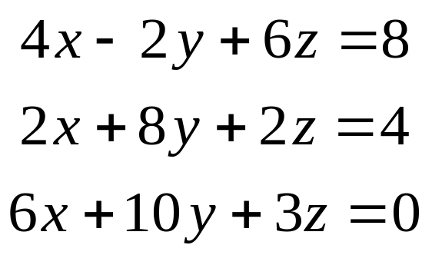
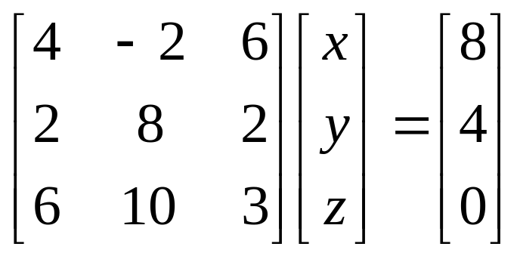
Solutions to Systems of Linear Equations
Example: Solving a system of linear equations
  A = [ 4 -2 6; 2 8 2; 6 10 3 ];
  B = [ 8; 4; 0 ];
  X = A \ B
  X =
  -1.8049
  0.2927
  2.6341

Slide 23
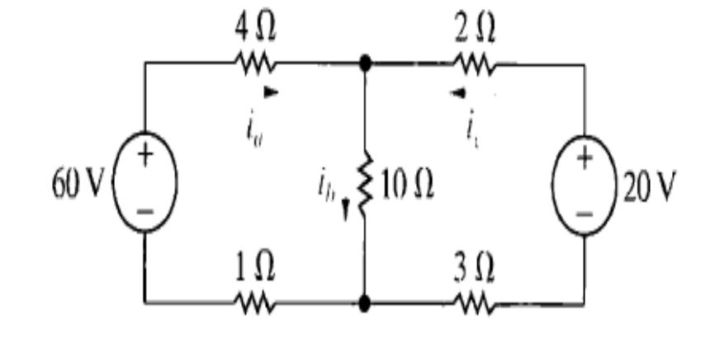








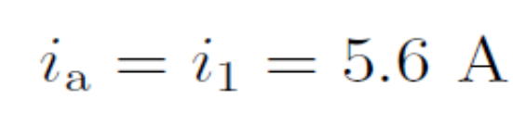
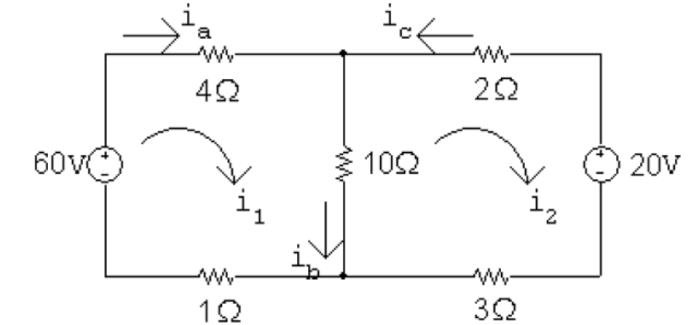
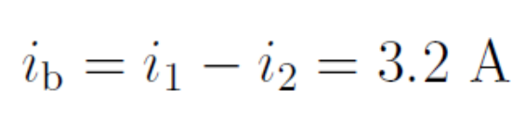
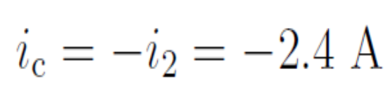

Slide 24
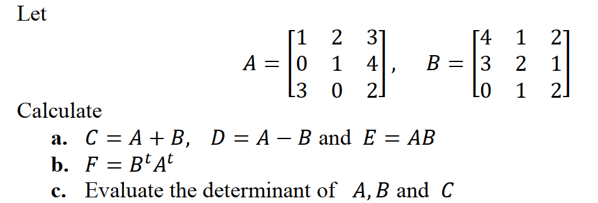
Exercise
Create the 3 x 3 matrix whose entries in the first row and first column are all equal to 1 and all the other entries are equal to e.
2.

Slide 25
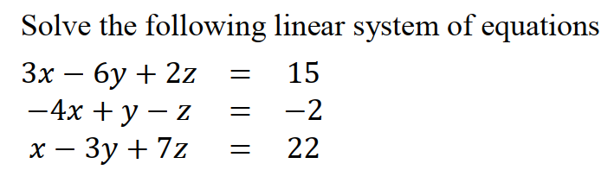
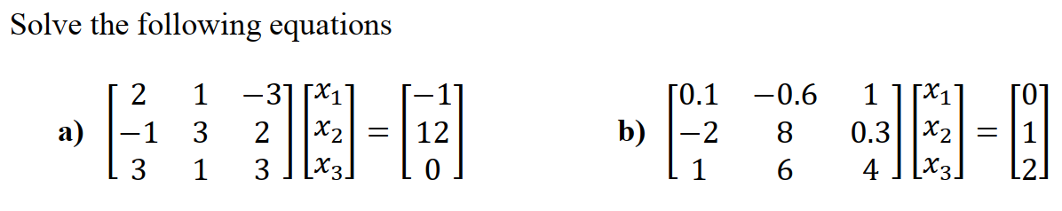
Exercise
3.
4.

